Slide 1

Android App Development Session 2

Slide 2
Contents
Layouts
Text View and Edit Text
Buttons
Widgets
Dialogs

Slide 3
Layouts
Linear Layout
Relative Layout
Frame Layout
Grid Layout
Table Layout
Constraint Layout

Slide 4
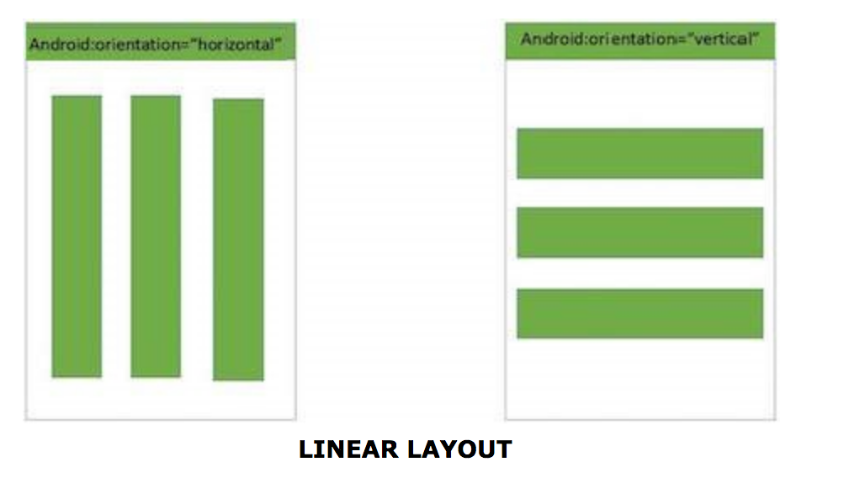
Linear Layout
Android Linear Layout is a view group that aligns all children
in either vertically or horizontally.

Slide 5
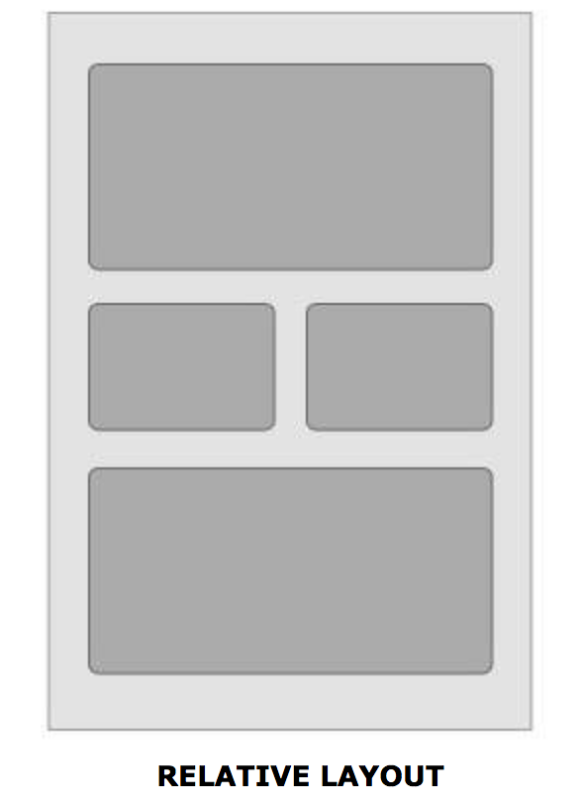
Relative Layout
Android Relative Layout enables you to specify how child views are positioned relative to each other.
The position of each view can be specified as relative to sibling elements or relative to the parent.

Slide 6
Frame Layout
Frame Layout is designed to block out an area on the screen to display a single item.
Generally, FrameLayout should be used to hold a single child view, because it can be difficult to organize child views in a way that's scalable to different screen sizes without the children overlapping each other.

Slide 7
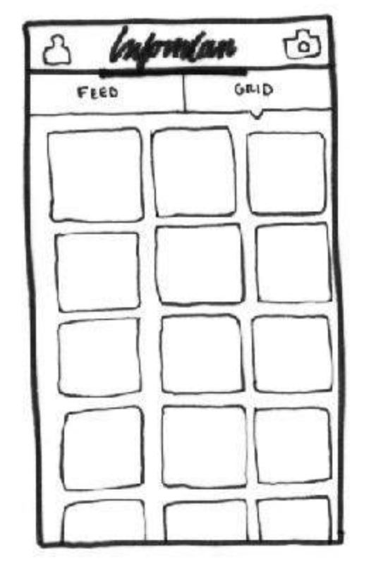
Grid Layout
Divide into rows and column.

Slide 8
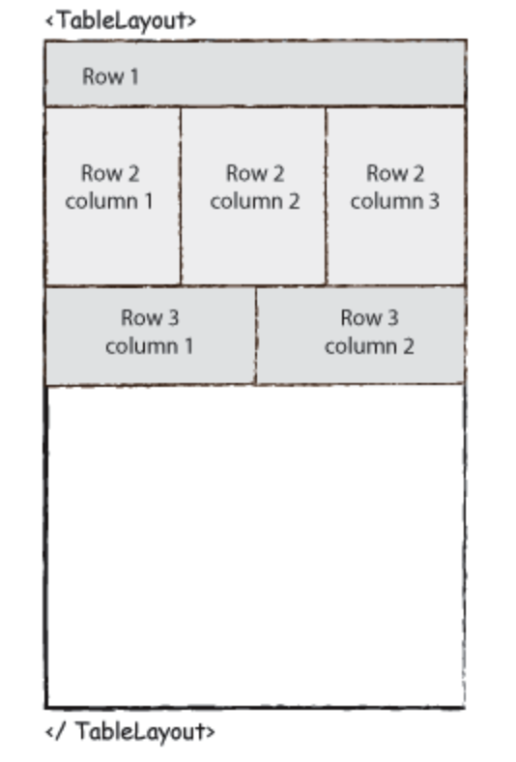
Table Layout
Android TableLayout going to be arranged groups of views into rows and columns.
You will use the <TableRow> element to build a row in the table.
Each row has zero or more cells; each cell can hold one View object.

Slide 9
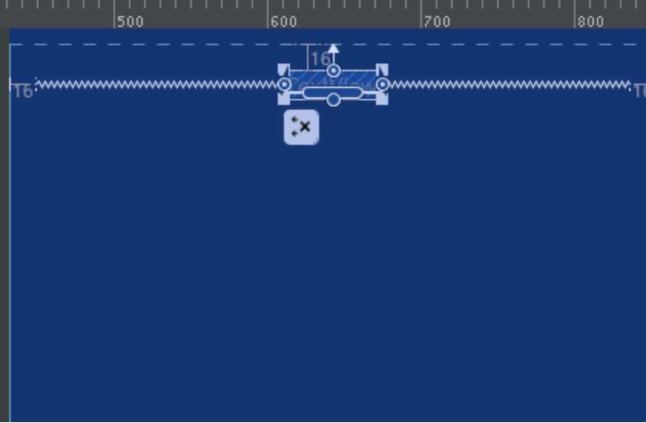
Constraint Layout
Android ConstraintLayout is used to define a layout by assigning constraints for every child view/widget relative to other views present.
Similar to Relative Layout.

Slide 10
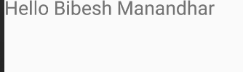

TextView & Edit Text
TextView
A TextView displays text to the user and optionally allows them to edit it.
A TextView is a complete text editor, however the basic class is configured to not allow editing.
EditText
A EditText is an overlay over TextView that configures itself to be editable.
It is the predefined subclass of TextView that includes rich editing capabilities.

Slide 11
Buttons
Button
ImageButton
ToggleButton
RadioButton

Slide 12
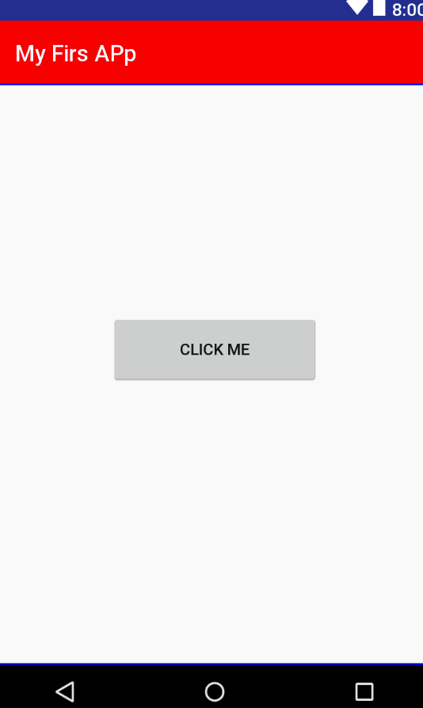
Button
A Button is a Push-button which can be pressed, or clicked, by the user to perform an action.

Slide 13
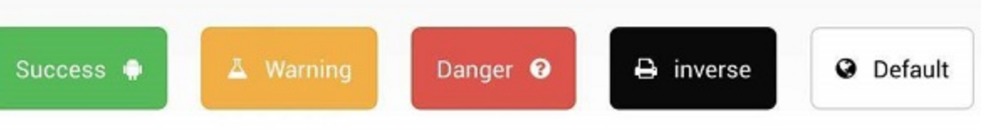
Image Button
An ImageButton is an type of button which shows a button with an image (instead of text) that can be pressed or clicked by the user.

Slide 14
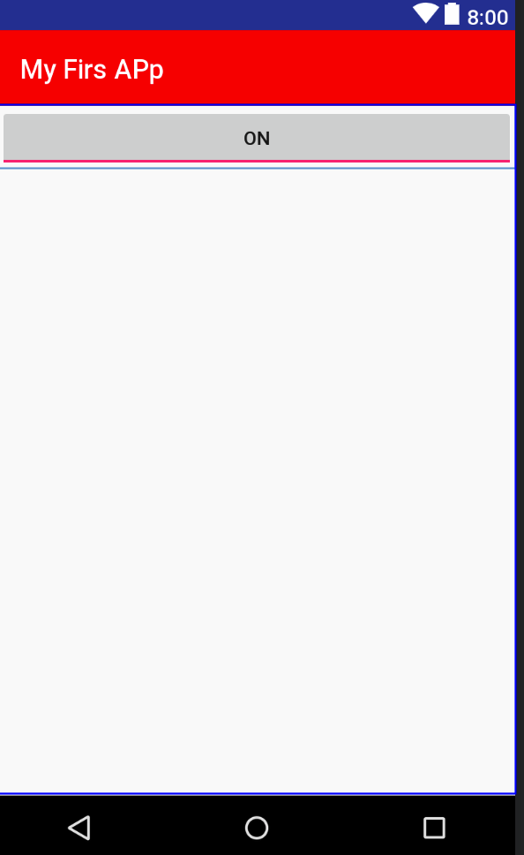
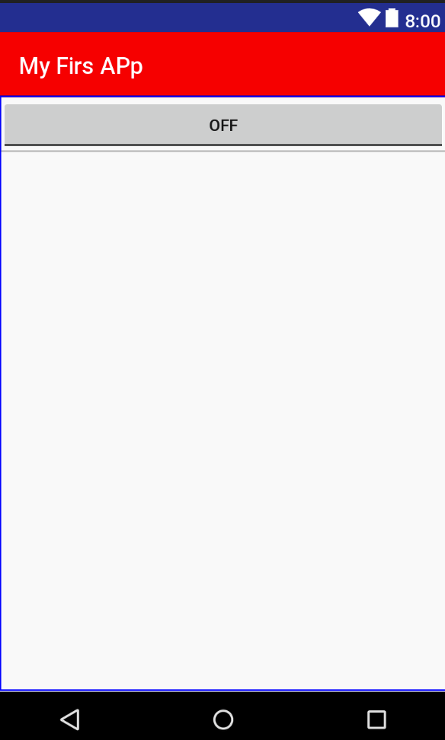
Toggle Button
A ToggleButton displays checked/unchecked states as a button.
It is basically an on/off button with a light indicator.

Slide 15
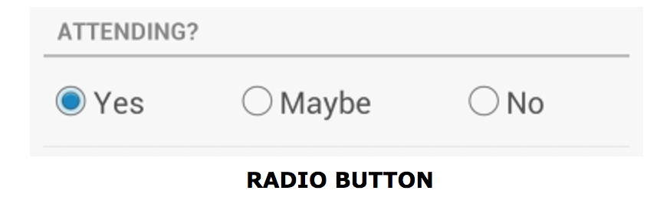
Radio Button
A RadioButton has two states: either checked or unchecked.This allows the user to select one option from a set.
Must be inside RadioGroup

Slide 16
Other Widgets
ImageView
Adding image in the view.
Spinner
A drop-down list that allows users to select one value from a set.
ProgressBar
Progress bars are used to show progress of a task. For example, when you are uploading or downloading something from the internet, it is better to show the progress of download/upload to the user.

Slide 17
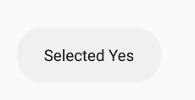
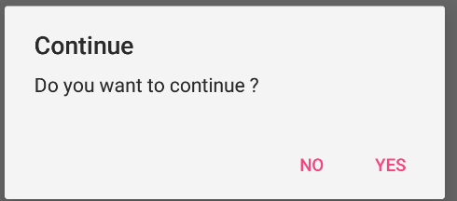
Dialog
Toast Message
Alert Dialog
Custom Dialog

Slide 18
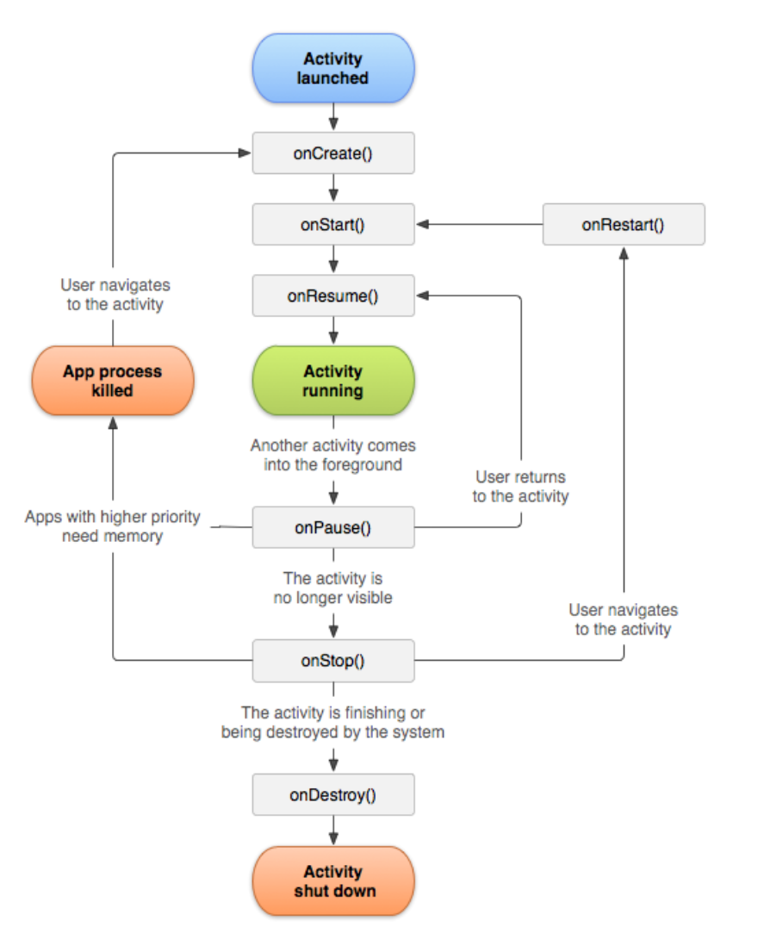
Activity Life Cycle

Slide 19
Let’s Start
<code/>

Slide 20
Thanks!
Any questions?
You can find me at bibesh.manandhar@gmail.com

Slide 21
References!
https://developer.android.com/
https://www.tutorialspoint.com/android/

